Slide 1
Kineticons: Using Iconographic Motion in Graphical User Interface Design
Zhichun Ye 1st Year Msc in Computer Science ye.zhic@husky.neu.edu

Slide 2
Take away
Graphical icon is an essential part of the successes of computers.
Other dimensions can be added to GUI to convey extra data, such as animation and auditory icons.
Kineticons can be applied and reused for a variety of elements, and can be recognized by different people.

Slide 3
Introduction
WHAT IS?
An iconographic scheme based on motion.
HOW IS?
Do not alter the visual content or pixels’ RGBA values of an element.
Image source: http://www.webappers.com/2007/07/31/webappers-simple-ajax-progress-bar-with-css/

Slide 4
Introduction
WHY MOTION?
Reuse
Smaller vocabulary set
Combination with other effects
Psychophysical benefits

Slide 5
Analyze an example
Drag-drop
Normal GUI
Image source: http://www.chrisharrison.net/
index.php/Research/Kineticon

Slide 6
Design
Drag-drop
Kineticons
Biological Motion, Gestures, Organic Motion, Mechanical Motion, Physics and Natural Effects, Cartoon Conventions
Image source: http://www.chrisharrison.net/
index.php/Research/Kineticon

Slide 7
Design
STATE
Ability/affordance of an item
Needs attention
Operation is progressing
Launching and opening
STATE CHANGES AND EVENTS
Entrance
Departure
Replace/upgrade
Positive/negative events

Slide 8
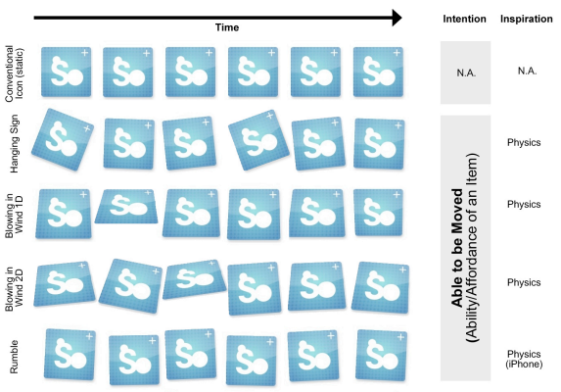
Kineticon Vocabulary
http://youtu.be/0GhfHO9clTY
Image source: http://www.chrisharrison.net/index.php/Research/Kineticon

Slide 9
User study
Goals:
Can motions be iconic and recognized across users?
Whether kinetic behaviors can be reliably applied across different GUI elements?
200 participants recruited for online study.
39 application icons, 4 best motions applied to menu item, dialog window, entire desktop.

Slide 10
User study
Each participant watched video of Kineticons.
While watching, they were asked to rate how strongly they agree or disagree with the interpretation of each icon, using 5-point Likert scale.
Each participant rated 10 kineticons, and answered background questions.

Slide 11
Results
36 of the 39 initial Kineticons are considered to convey some particular meanings than others.
Several Kineticons performs are related (positive or negative)conceptually, and performs well in two categories.
Most MacOSX existing kinetic icons: Shake No, Zoom and Suck In are performing good. Rumble is less successful.

Slide 12
Results
3 (Heart Beat, Blowing in the Wind 2D, and X-cross)of 4 Kineticons performs well across GUI elements.
1 another (Running) doesn’t generalize to all GUI elements, only performs well in application icon.
Need to carefully and fully test all the vocabularies.

Slide 13
Kineticons’ sparking points
Human’s ability to process parallel information, and motion is eye-grasping.
Motions can be applies to different sizes of GUI elements.
Requires a smaller motion icon set.
Can be combined with other dynamic visual effects, thus convey more information.

Slide 14
Kineticons’ limitations
Authors note that
Motion is attention grabbing.
Some Kineticons perform well only in an particular GUI element.
Several Kineticons are conceptually related thus can cause confusion.

Slide 15
Study’s missing …
Stay on video display, doesn’t apply to real operating system, are not triggered simultaneously.

Slide 16
Study’s missing …
Insufficient motion behaviors applied to other GUI elements: based on the selection of Kineticons with great performance on application icon.

Slide 17
Study’s missing…
Rate satisfaction only within the Kineticons vocabularies, no comparison with normal icons.

Slide 18
Next step is …
Collect user feedback on how they would represent a particular interaction using motion icons and use these as inspirations of design.
Broaden the vocabulary and interaction category.

Slide 19
Next step is …
Real-world experiment: apply Kineticons to real operating systems, allow participants to rate them under real working circumstance.
Create comparison-group: for each Kineticon in the vocabulary, participants select which icon they prefer: Kineticon or normal icon with no motion.

Slide 20
Summary
Motions can be applied together with other iconographic schemes and across GUI elements.
It comes with restrictions and its effectiveness depends.
Careful testing and iterative design is necessary.
More comparison group experiments are needed.

Slide 21
Discussion questions
Do you like Kineticons? Why or why not?
How to solve the correlations between interpretations? Redesign? Choose one and let user get used to it?

